Slide 1
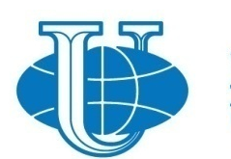
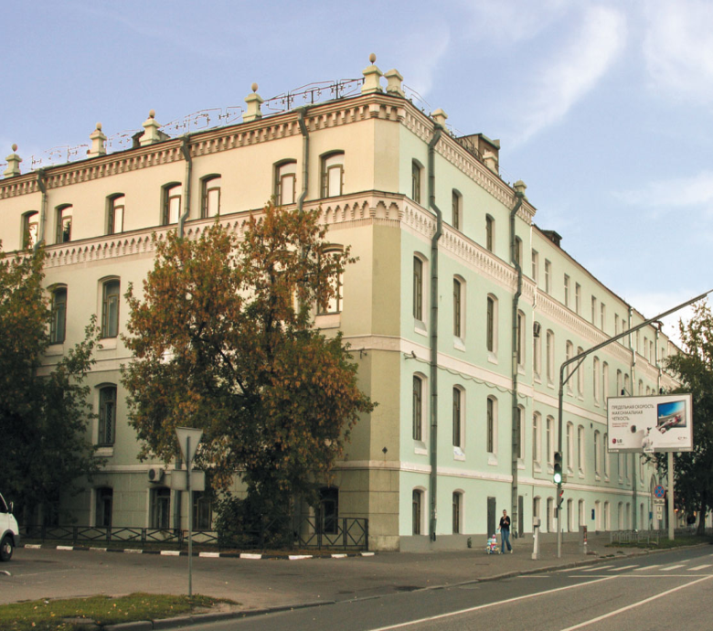
PEOPLES’ FRIENDSHIP UNIVERSITY OF RUSSIA
ECOLOGICAL FACULTY
Faculty of Ecology
Master program
Economics
of natural resources management

Slide 2
Sustainability in RUDN:
Research and training
28 years experience in training of environmental specialists - one of the first ecological faculties in Russia
practice-oriented master and bachelor programs
100% defense of graduate works presented in foreign languages - evidence of the quality of language training
Over 90% of Russian and foreign graduates of the faculty are employed
Over 50 scholarships, diplomas, certificates for scientific research were won in 2019 by our students
Since 2017: RUDN - one of the first Russian Universities presented the Environmental policy

Slide 3
RUDN-University: science for the sustainable development
Stability of the natural systems;
Environmental safety in oil and gas sector;
HSE-management;
Monitoring and modeling of the behavior of super toxic compounds in the environment;
Conservation of the biodiversity;
Biocommunication;
Climate preservation;
Environmental biotechnology;
Waste management and recycling;
Forensic ecology
Human ecology;
Sustainable cities;
Sustainable agroecosystems
Food security;
Environmental geochemistry;
Protection of water resources;
Ecological and economic
assessments of enterprises;
Environmental management;
Innovative technologies for the environmental education

Slide 4
Faculty of Ecology
Green faculty - green university. The faculty is the initiator of several programs
on greening of the university and its positioning in the green universities initiative.
RUDN holds the first place in Russia in the international rating of green universities
Green Metric World University Ranking, and among the world's higher education institutions ranked 38st in 2019.
LLL-education. More than 50 continuous education programs are designed and implemented at the faculty. They are available not only for specialists "from outside", but also for own students. The programs include the most topical issues of ecology, nature management, education, design and other areas.
Innovative educational programs: unique author's courses and findings are applied: courses on waste management, forensic ecology, environmental regulation, HSE-management. A virtual simulator is used for the training in ecological safety of oil transport, where the student can simulate and eliminate the accident on the pipeline himself, feeling "inside the accident". Since 2018 – 6 massive open online courses: Environmental standards and norms for the sustainability; Global and local climate change: control & modeling; HSE-management and audit; International environmental management: municipal solid waste, hazardous waste & wastewater; Management of energy resources; Surface water pollution: control and modeling

Slide 5
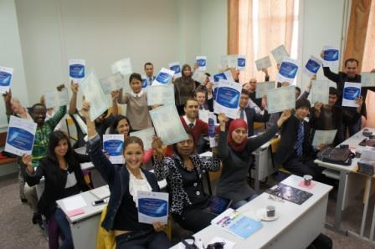
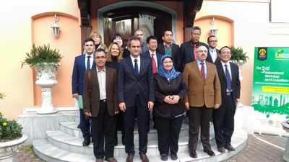
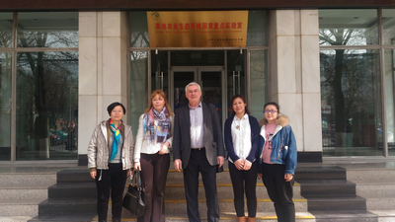
Faculty of Ecology
Academic mobility. Studying on the programs of included education in cooperation with foreign universities allows students to gain invaluable experience - education abroad, participation in student life with their foreign peers, acquaintance with the culture and science of the country, language and professional practice. The faculty implements master's programs in collaboration with the universities of Italy, China, Kazakhstan, Belarus.
Research directions:
Environmental safety in the oil and gas sector;
Monitoring and modeling the behavior
of toxic compounds in the environment;
Use management
Biodiversity conservation;
Climate conservation;
Environmental biotechnology;
Waste recycling;
Forensic ecology and human ecology.

Slide 6
Education: main programs
Bachelor degree
Ecology and nature management
Energy and resources saving technologies in chemical technology,
petrochemistry and biotechnology
Master degree
Rational nature management
Expertise of environmental safety of nature management
Waste recycling
Sustainable development and use of natural resources (coop. with Uni Palermo)
Marine Environment (coop. with Uni Tuscia)
Nature management (USCO)
Economics of natural resources management
Urban ecology
HSE-management
Integrated waste management
PhD programs
Ecology
Geoecology
Modern environmental studies – in cooperation with:
  Vytautas Magnus University, Lithuania
  Belarus Sate University, International State Ecological Institute

Slide 7
Master program
“Economics of natural resources management”
The aim of the educational program is to prepare highly qualified specialists in demand on the labor market with an active lifestyle, wide erudition and a high level of skills in the field of environmental economics, environmental management, environmental protection and nature management.
The specifics of the professional activity of graduates is determined by the orientation of their training: this is the activity at the junction of economic science and practice with the environmental direction, as well as resource management and environmental management in general. The complex nature of professional activity requires high-quality training on a wide range of issues related to the organization and management of environmental management based on a clear understanding of economic mechanisms

Slide 8
Master program
“Economics of natural resources management”
2-year master program aimed on the problems of assessment of natural resources, assessment of their quality and approaches to the efficient use of resources as well as their conservation and restoration.
Main special (professional) disciplines
Estimations of natural resources
Management of environmental-economic risks
Management of natural resources
Economic aspects of natural resources management
Methodology of scientific creation
Environmental normalization
Ecologic-economical aspects of environmental projects
Industrial nature management and economics
Modern technologies for nature protection
Integrated management systems
Wastes: Landfills, Processing and Recycling d management systems

Slide 9
Your opportunities in
“Economics of natural resources management”
New faces – new country – new friends
Opportunity to study in the leading Russian university with a long-term traditions of training of foreign students.
One of the most popular and actual modern educational directions
Good carrier prospective with the master degree in the economics of natural resources management
Social and cultural events in the multicultural environment of the university
Work with the leading Russian professors – experts in ecology, nature management, sustainability
Academic mobility (maintained with scholarships)
Acquaintance with Russian experience of nature management
Access to all the student services of RUDN, incl. a big scientific library with an access to the foreign collections
Your two supervisors help you to get more expertise in your research field
More chances on labor market with more experience in not only the “domestic” nature management praxis

